Slide 1
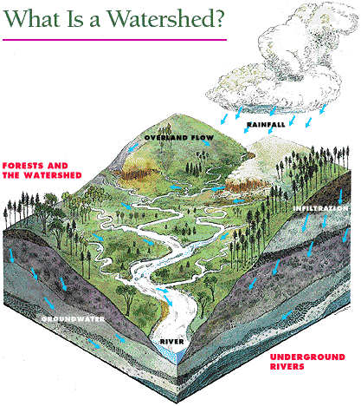

Slide 2
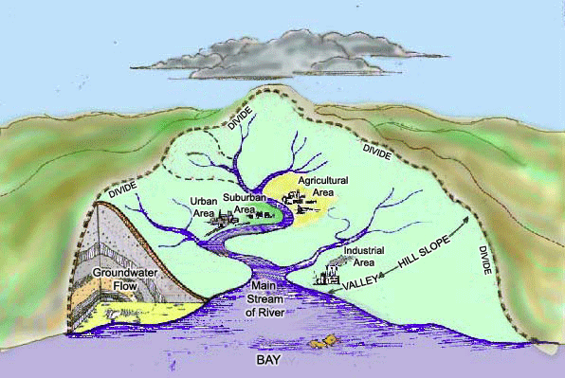
What is a watershed?
It is the area of land and waterways that drain to a water body.

Slide 3
Texas Watersheds

Slide 4
Trinity River Basin
Source: Texas Water Development Board

Slide 5
Trinity Watershed
Source: USGS

Slide 7
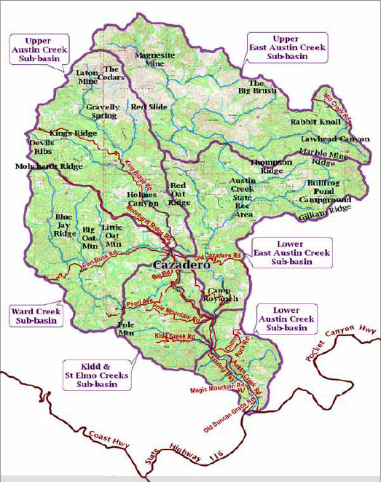
In Austin, rainwater flows over land to our creeks and lakes, and underground into the aquifer. For example, rain water in the Barton Creek Watershed drains into Barton Creek.

Slide 8
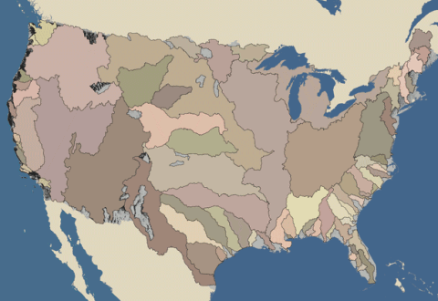
United States Watersheds

Slide 9
Texas Aquifers

Slide 10
Zones

Slide 11
Everyone lives in a watershed. You and everyone in your watershed are part of the watershed community. You influence what happens in your watershed, good or bad, by how you treat the natural resources, the soil, water, air, plants, and animals. What happens in your small watershed also affects the larger watershed downstream.

Slide 12
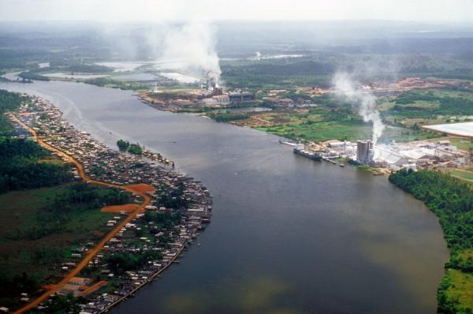
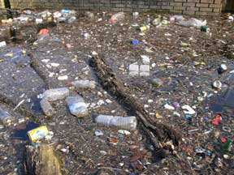
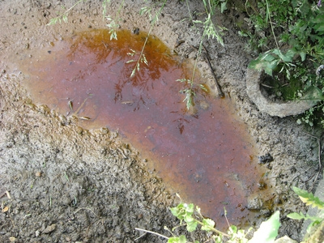
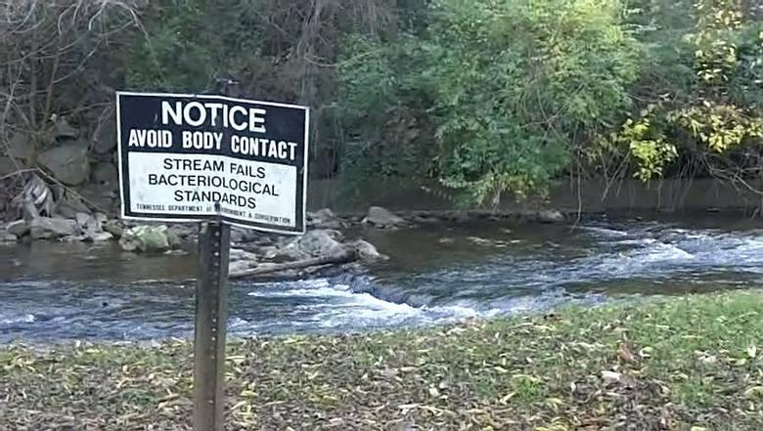
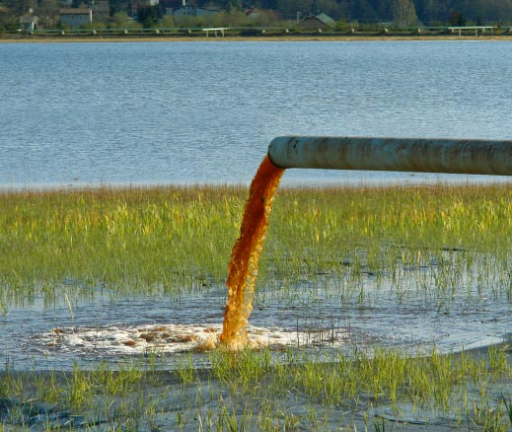
Water Pollution

Slide 13
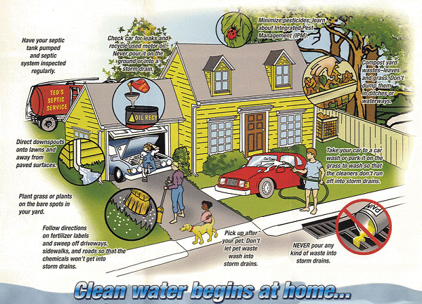

Slide 14
There are two types of water pollution, point source and non-point source.
Point source pollution is pollution that is directly put in to the water.
Non – point source is pollution that happens somewhere else and then runs into the water.

Slide 15
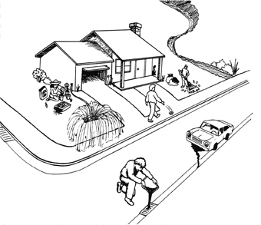
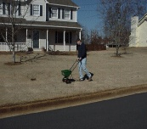
Your yard flows to your creek...
Most pollutants that are on the land (car fluids, yard chemicals, trash and
debris) come from us. These pollutants are picked up by rainwater and
carried to our creeks.

Slide 16
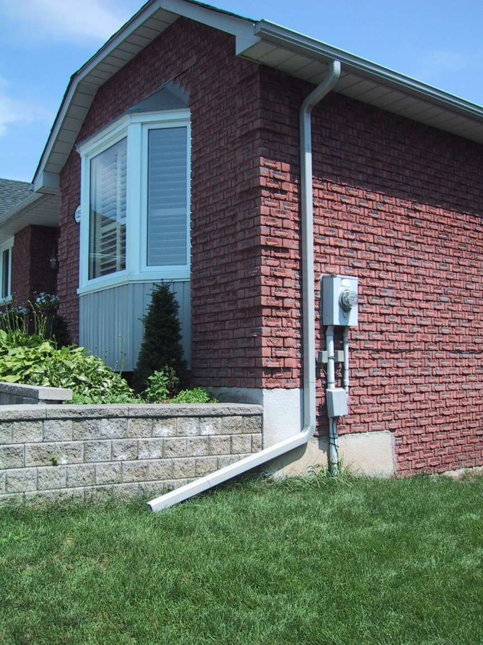
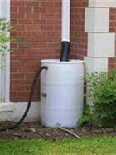
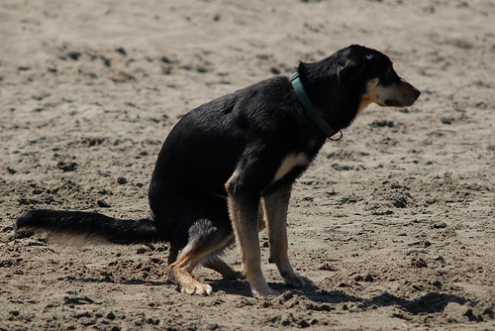
Make good choices for water quality
Keep water on your land
Direct gutter downspouts to vegetated areas rather than pavement
Irrigate efficiently to avoid runoff from your yard
Minimize pavement to allow water to soak into the ground
Pick up feces that your animal deposits on you lawn

Slide 17
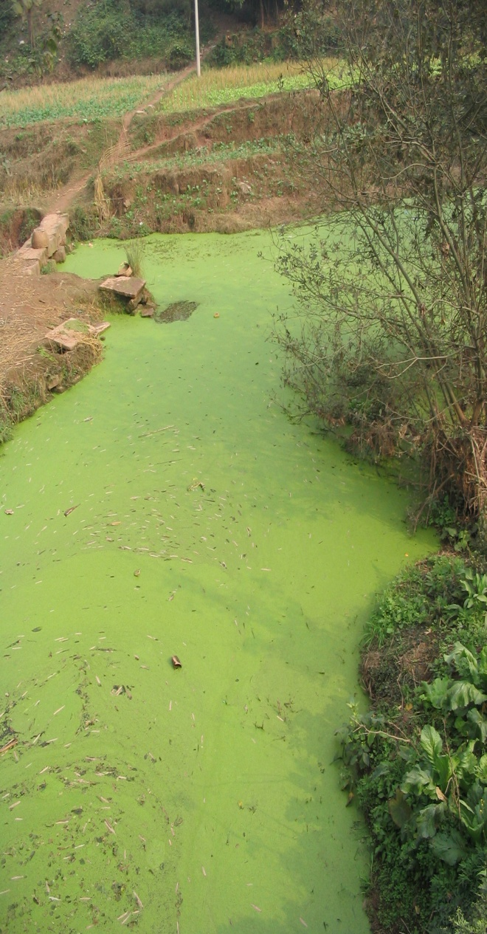
The Hazards of Fertilizers
The fertilizers that are applied to land for agricultural or recreational use can enter watersheds through water runoff..
When phosphates from fertilizer are introduced into water systems, higher concentrations cause increased growth of algae and plants. Algae tend to grow very quickly under high nutrient availability, but each alga is short-lived, and the result is a high concentration of dead organic matter which starts to decay. The decay process consumes dissolved oxygen in the water, resulting in hypoxic conditions. Without sufficient dissolved oxygen in the water, animals and plants may die off in large numbers.
http://en.wikipedia.org/wiki/Algal_bloom

Slide 18
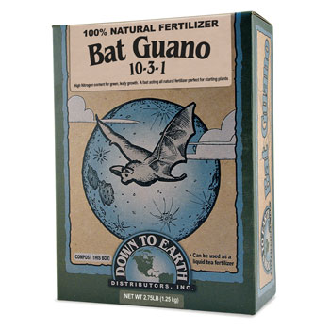
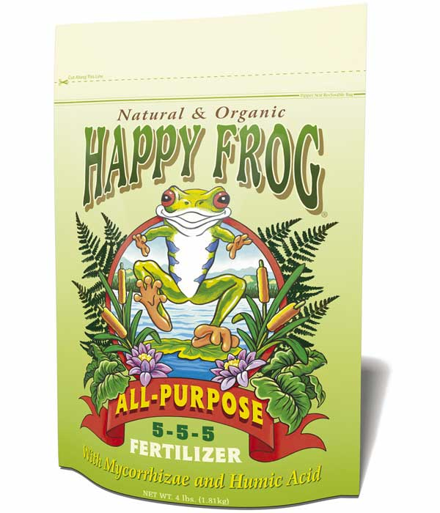
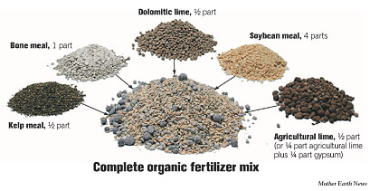
Use earth-wise gardening solutions
• Use certified organic or natural fertilizers if necessary
• Reduce fertilizer application rates to half as much, half as often as recommended on the bag
• Use pesticides as a last resort
• Never use lawn chemicals before rain is expected
• Plant or mulch bare spots to prevent erosion

Slide 19
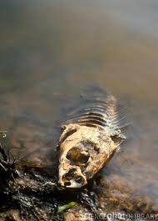
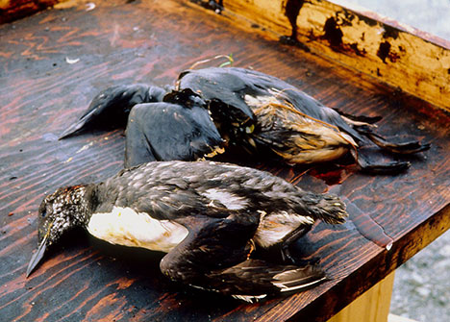
Reduce chemical spills
• Store chemicals properly
• Maintain your car to prevent leaks
• Recycle used motor oil at gas stations
• Drop off excess chemicals at the Household

Slide 20
Wells
Why did the well go dry?
How did that affect the stream?

Slide 21
How do you humans affect the aquifers?

